Slide 1
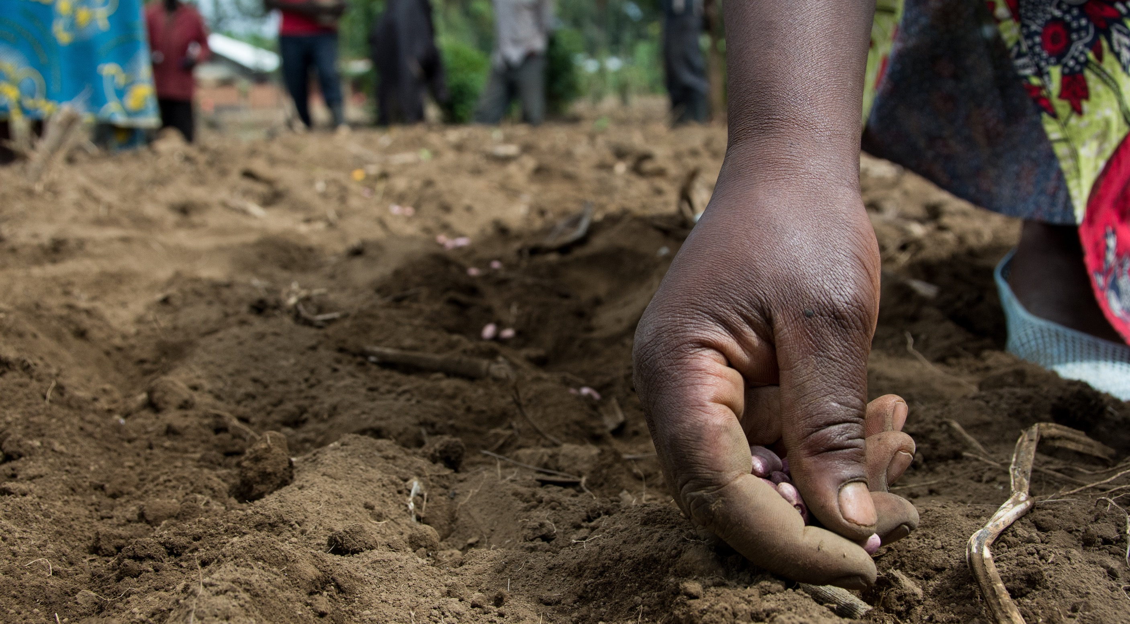
THE AU POLICY FRAMEWORK ON FARMER-MANAGED SEED SYSTEMS IN AFRICA
WHY THIS POLICY MATTERS: RIGHTS, POWER, AND THE FUTURE OF SEED GOVERNANCE
BY MARIAM MAYET, AFRICAN CENTRE FOR BIODIVERSITY

Slide 2
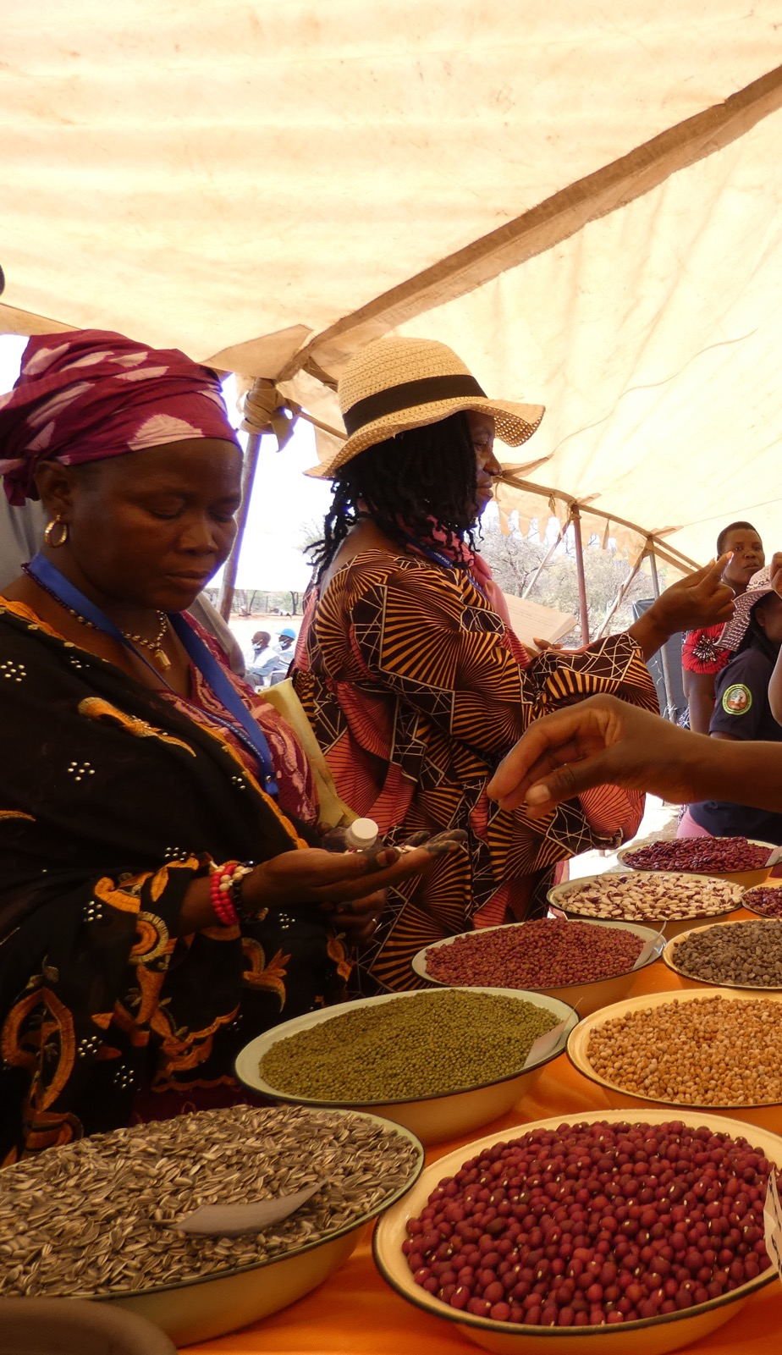
WHY THIS POLICY MATTERS NOW
  This is not a minor technical policy.
  It could shape how national seed laws, plant variety protection, biodiversity governance, and public support systems evolve across Africa.
  It comes at a moment of intensified pressure from:
    Seed harmonisation
    International Union for the Protection of New Varieties of Plants (UPOV)-style legal reforms
    Corporate concentration
    Digitalisation of seed governance
  The central issue is not only whether farmer-managed seed systems (FMSS) are recognised.
  It is on whose terms they are recognised—and whether recognition protects or disciplines them.

Slide 3

THE POLITICAL STAKES
THE STRUGGLE OVER FMSS IS A STRUGGLE OVER POWER.
  Who defines what counts as “quality”, “legitimate seed”, and “recognised varieties”?
  Who controls the rules, the institutions, and, increasingly, the data?
  Will FMSS be protected as living, farmer-governed systems?
  Or be absorbed into formal seed-sector logics through:
    Registration
    Certification
    Traceability
    Performance metrics
    Market integration

Slide 4
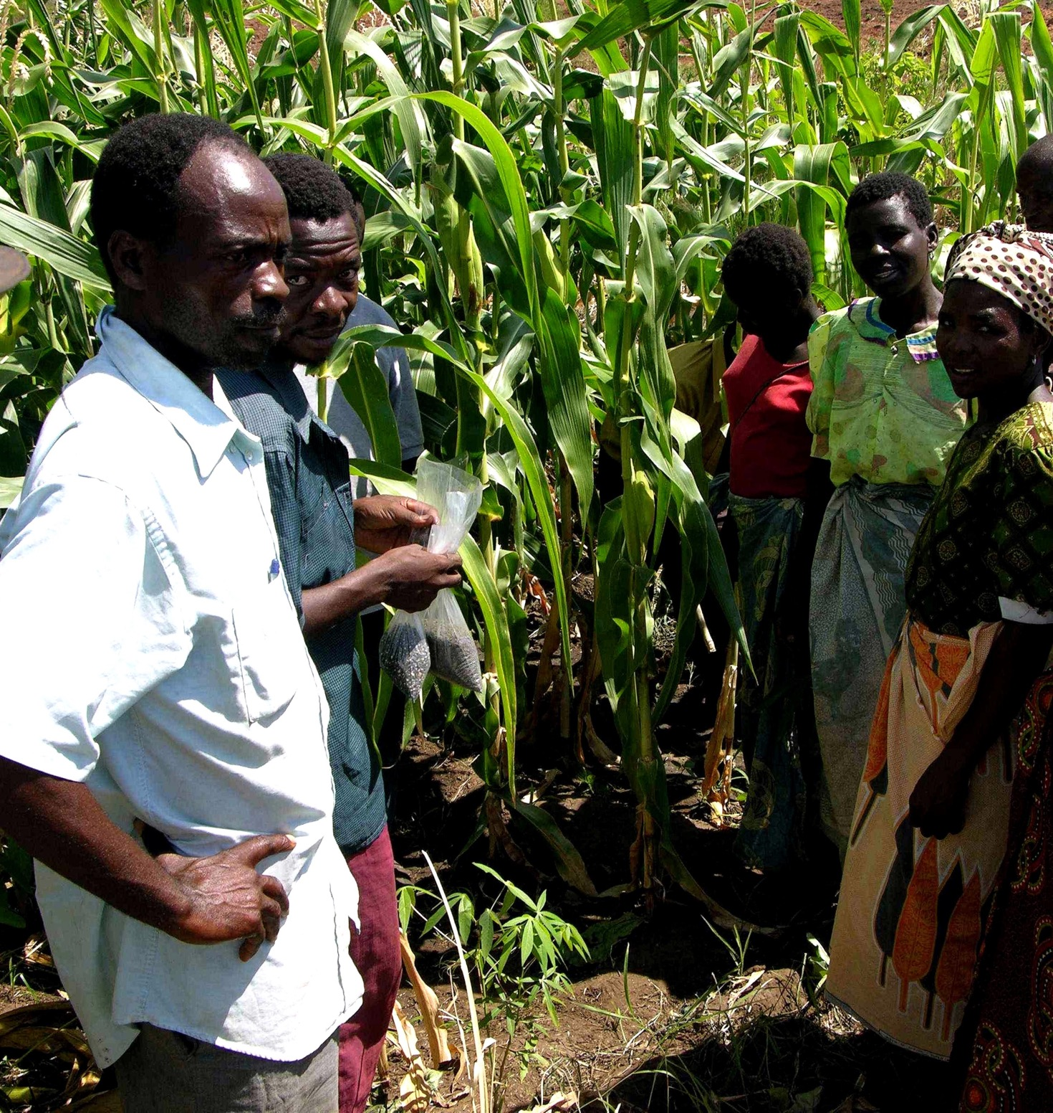
CORE ARGUMENT
  The draft African Union (AU) policy makes an important opening by recognising FMSS.
  But recognition alone is not enough.
  As currently framed, the policy remains too weak on:
    Farmers’ Rights
    Legal protection from criminalisation
    FMSS autonomy and non-subordination
    Safeguards against UPOV-style harmonisation
    Farmer-controlled quality systems
    Corporate and digital forms of capture
  The real question is whether the policy will secure protected legal space for FMSS or simply make FMSS more visible to systems designed elsewhere.

Slide 5
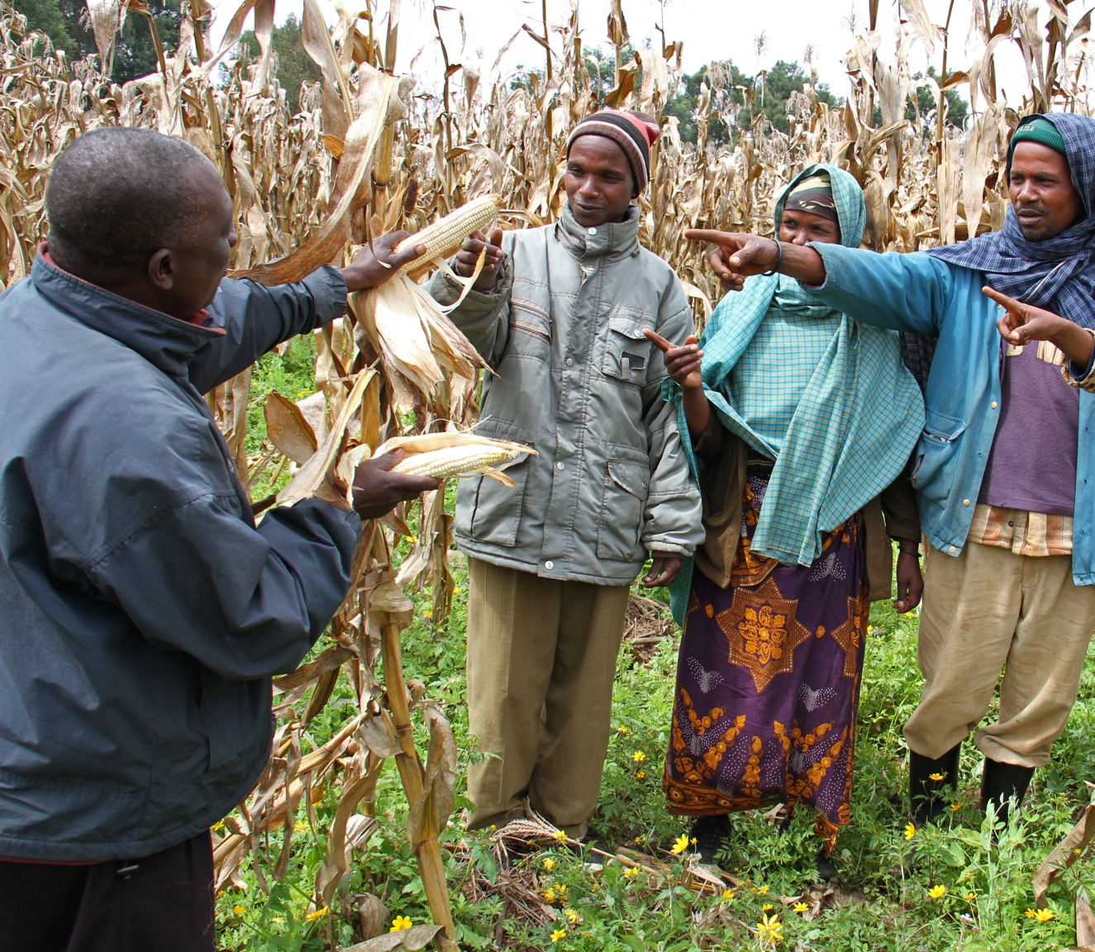
IMPORTANT DISTINCTION: POLICY VS STRATEGY
  The policy framework should set the normative and legal direction.
  The strategy deals with implementation, financing, monitoring, and institutional arrangements.
  This presentation focuses on the policy.
  The strategy raises additional questions, but those will be addressed separately.
Why this matters: If the policy is weak, the strategy may operationalise that weakness.

Slide 6
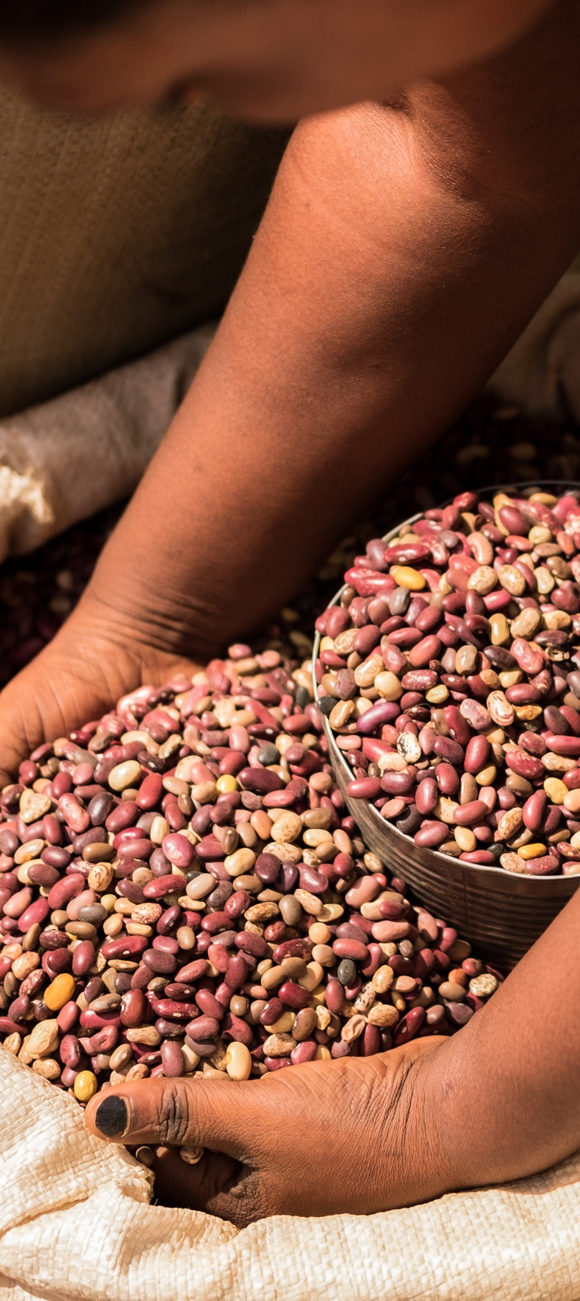
WHAT THE POLICY GETS RIGHT
  Draft makes an important political move by recognising FMSS as central to:
    Seed access
    Agricultural biodiversity
    Climate adaptation
    Nutrition
    Local seed economies
  It helps push back against the idea that FMSS are merely “informal residues” of the past.
  It acknowledges the role of:
    Seed-saving, exchange, selection, and replanting
    Women’s knowledge and labour
    Local adaptation and resilience
  It opens space for Member States to move toward more plural seed systems.
THIS RECOGNITION MATTERS—BUT IT IS ONLY A STARTING POINT.

Slide 7
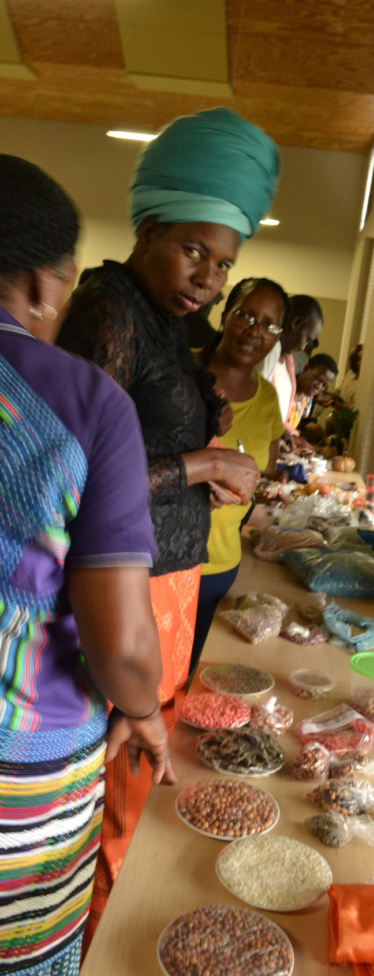
RECOGNITION NOT THE SAME AS PROTECTION
  Key weakness of the draft is that it recognises FMSS without fully protecting them.
  It does not clearly convert principle into:
    Enforceable rights
    Legal safeguards
    Limits on regulatory overreach
    Obligations on Member States
  This leaves a dangerous gap between symbolic inclusion and real legal security.
  FMSS may be welcomed in rhetoric while still being squeezed by:
    Seed laws
    Certification rules
    Plant variety protection
    Registration systems
    Harmonisation agendas
A POLICY THAT RECOGNISES FMSS, BUT DOES NOT SHIELD THEM FROM HOSTILE LEGAL REGIMES, LEAVES THEM EXPOSED.

Slide 8

THE MISSING RIGHTS FRAMEWORK
THE POLICY STILL LACKS A SUFFICIENTLY STRONG FARMERS’ RIGHTS FOUNDATION.
  It references international instruments, but does not adequately operationalise:
    The International Treaty on Plant Genetic Resources for Food and Agriculture (ITPGRFA) Article 9
    The United Nations Declaration on the Rights of Peasants and Other People Working in Rural Areas (UNDROP) Article 19
  It should clearly affirm farmers’ rights to:
    Save, use, and exchange seed
    Sell farm-saved seed
    Maintain, develop, and govern their seed systems
  It should also protect:
    Traditional knowledge
    Participation in decision-making
    Benefit-sharing
    Community control over seed-related knowledge and data
FMSS SHOULD NOT BE RECOGNISED ONLY AS USEFUL SYSTEMS, BUT AS RIGHTS-BEARING SYSTEMS.

Slide 9
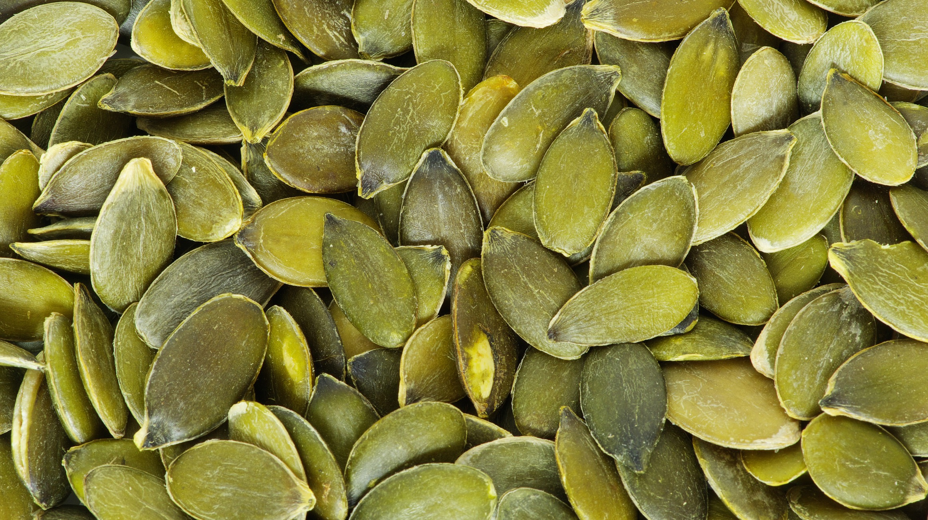
THE INTEGRATION TRAP: WHEN RECOGNITION BECOMES SUBORDINATION
  The draft often promotes:
    Integration and complementarity
    Alignment with national seed systems
  But in practice, “integration” can mean:
    FMSS must fit formal standards
    Farmer varieties are absorbed into bureaucratic categories
    Local systems lose autonomy
    Diversity is squeezed into commercial seed logic
  This is why the policy needs explicit non-subordination language.
  FMSS must not be treated as a junior branch of the formal seed sector.
What should be stated clearly:
  FMSS are autonomous and legitimate seed systems.
  Farmer seed exchange and local circulation must not be regulated as if they were formal commercial trade.
  Recognition pathways must not become pathways of control.
THE QUESTION IS NOT WHETHER FMSS IS INTEGRATED, BUT ON WHOSE TERMS.

Slide 10
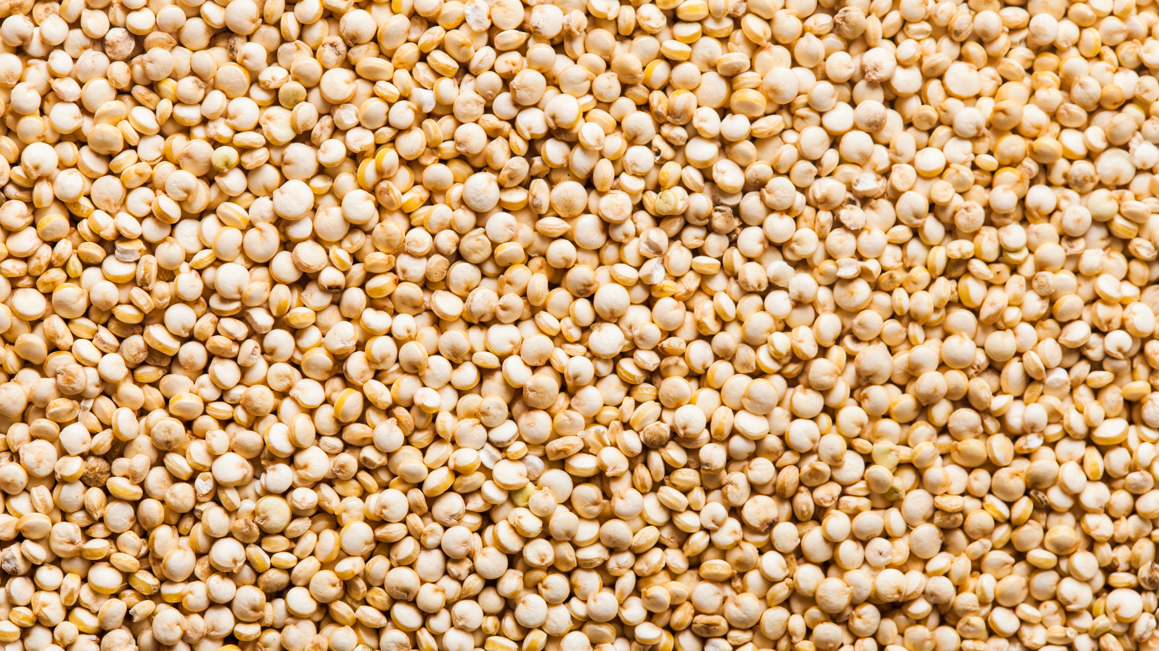
QUALITY ASSURANCE: MAIN PRESSURE POINT
  The language on quality assurance may appear technical, but it is one of the most politically significant parts of the policy.
  The risk is that “quality” becomes the route through which FMSS are gradually disciplined into formal seed regulation.
  Key unanswered questions include:
    Who defines quality?
    Is it voluntary or mandatory?
    Is it farmer-governed or regulator-governed?
    Is it distinct from certification?
    Does it respect local adaptation and diversity?
A rights-based approach would require quality assurance to be:
  Participatory
  Community-based
  Farmer-governed
  Adapted to local agroecologies
  Clearly distinct from commercial certification systems
IF QUALITY ASSURANCE IS NOT CAREFULLY DEFINED, IT CAN BECOME THE POLICY’S MOST EFFECTIVE INSTRUMENT OF CONTROL.

Slide 11
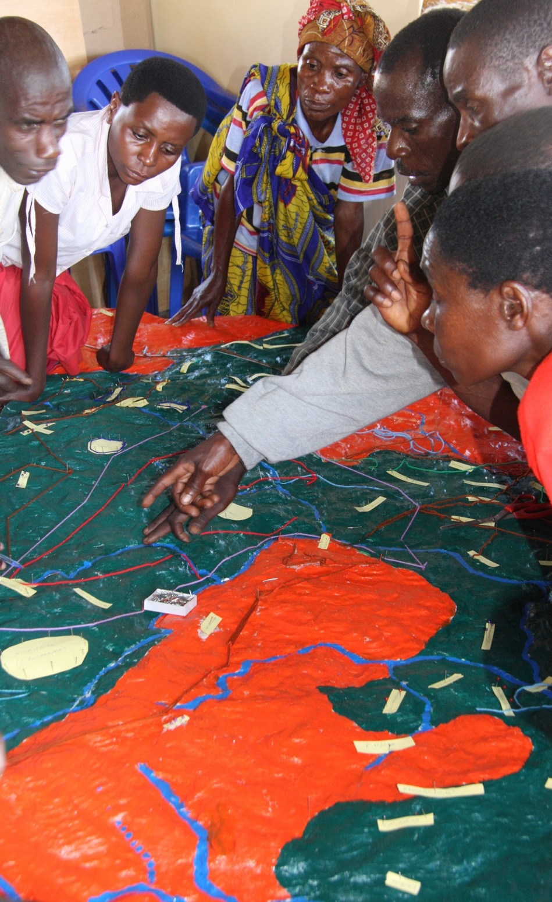
CRIMINALISATION AND THE NEED FOR LEGAL PROTECTION
  One of the clearest weaknesses in the draft is the absence of strong protection against the criminalisation of ordinary farmer seed practices.
  Across Africa, farmers can be exposed through seed, marketing, and plant variety protection laws that restrict or penalise:
    Saving and exchanging seed
    Local sale of farm-saved seed
    Circulation of unregistered or uncertified varieties
  The policy should state clearly that customary farmer seed practices must not be treated as illicit by default.
  It should call on Member States to review laws that criminalise or unduly restrict farmer-managed seed systems.
WITHOUT PROTECTION FROM CRIMINALISATION, RECOGNITION REMAINS FRAGILE AND CONDITIONAL.

Slide 12
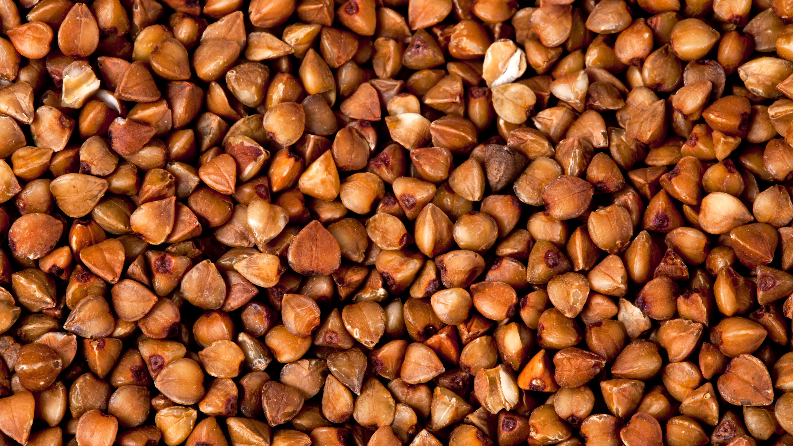
UPOV, HARMONISATION, AND REGISTRATION PRESSURES
  The policy does not sufficiently confront the wider legal environment in which FMSS must survive.
  That environment includes:
    UPOV-style plant variety protection
    Harmonised regional seed trade rules
    Registration requirements
    Distinct, Uniform and Stable (DUS)-based varietal criteria
    Expanding certification systems
  These are not neutral technical tools. They often privilege:
    Uniformity over diversity
    Commercial breeding over farmer selection
    Formal market circulation over local exchange
  If the policy remains silent on these structural pressures, FMSS can be recognised rhetorically while being narrowed in practice.
What the policy should make explicit:
  No compulsory DUS or commercial-style registration for farmer varieties circulating within FMSS.
  No automatic subjection of local seed systems to formal commercial seed rules.
  Explicit safeguards against harmonisation models that erode Farmers’ Rights.
THE REAL TEST IS WHETHER THE POLICY PROTECTS FMSS FROM HOSTILE LEGAL CONVERGENCE.

Slide 13
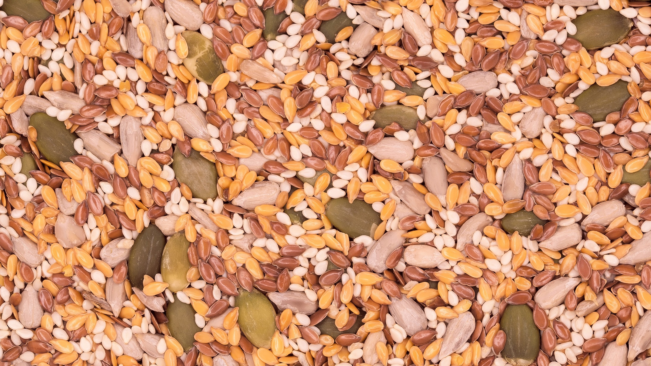
CORPORATE CONCENTRATION AND CAPTURE
  The policy speaks positively about markets, enterprises, and competitiveness but says far too little about power.
  Seed systems are shaped by growing concentration in:
    Breeding
    Seed markets
    Intellectual property
    Digital platforms
    Input and distribution chains
  In this context, support for market participation can easily become a route to:
    Dependency and co-option
    Policy capture
    Displacement of farmer-governed systems
  FMSS need protection not only from hostile regulation, but also from forms of incorporation that subordinate them to commercial agendas.
What is needed in the policy:
  Clear conflict-of-interest safeguards.
  Public-interest limits on corporate influence over FMSS governance.
  Protection of farmer seed systems as public goods, not merely emerging market segments
WITHOUT ANTI-CAPTURE SAFEGUARDS, SUPPORT FOR FMSS CAN BECOME A PATHWAY TO THEIR COMMERCIAL ABSORPTION.

Slide 14

1. Farmers’ Rights / Right to Seed
  Explicit grounding in ITPGRFA Article 9.
  Explicit reference to UNDROP Article 19.
2. Protection from criminalisation
  No penalisation of customary seed-saving, exchange, use, and local sale within FMSS.
3. FMSS autonomy
  Clear recognition of FMSS as autonomous, legitimate, and dynamic seed systems.
  Explicit non-subordination to the formal seed sector.
4. Limits on regulatory overreach
  No compulsory DUS, certification, or commercial registration for farmer varieties circulating within FMSS.
  Quality assurance must be distinct from commercial certification.
5. Safeguards against capture
  Stronger protection against corporate, legal, and administrative capture of FMSS.
POLICY REDLINES: WHAT MUST CHANGE
IF THESE REDLINES ARE ABSENT, THE POLICY RISKS RECOGNITION WITHOUT PROTECTION.
FOR THE POLICY TO BE CREDIBLE, SEVERAL NON-NEGOTIABLE ELEMENTS ARE NEEDED.

Slide 15
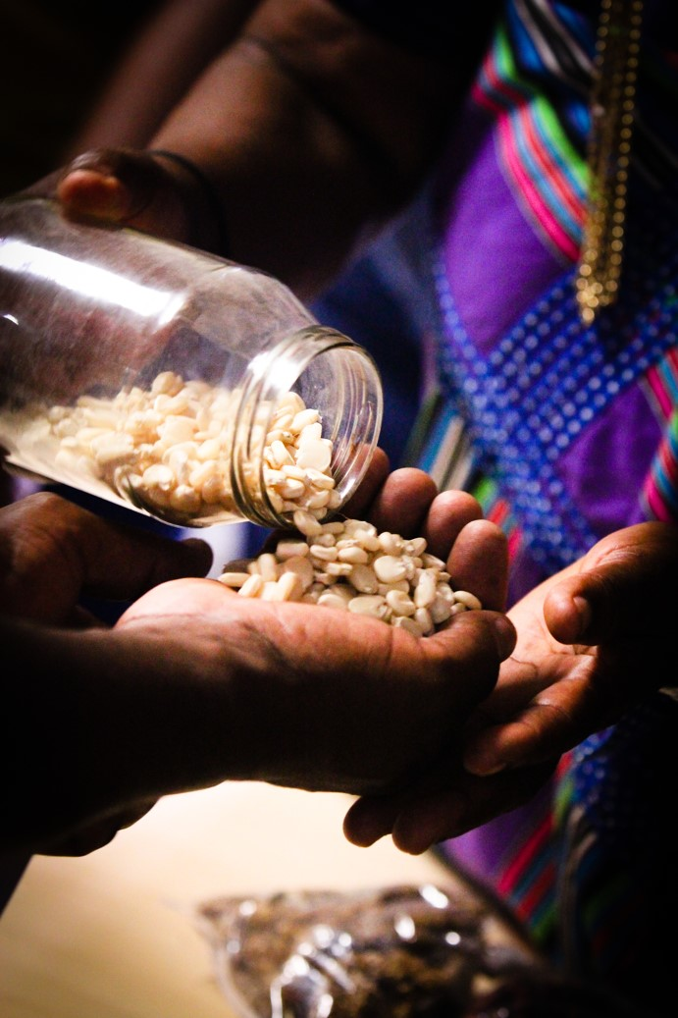
CONCLUSION
  The AU policy framework creates an important opening by recognising FMSS.
  But the central issue is whether this recognition will secure:
    Rights
    Legal space
    Autonomy
    Farmer-governed quality systems
    Protection from enclosure and capture
  As currently drafted, the framework still falls short of that standard.
  The danger is not only exclusion.
  The danger is also managed through inclusion on terms set from above.
FMSS must be protected as living systems of biodiversity, food sovereignty, and farmers’ rights—not merely incorporated into the formal seed sector under softer language.
The question is not whether FMSS are recognised, but whether they are defended.

Slide 16

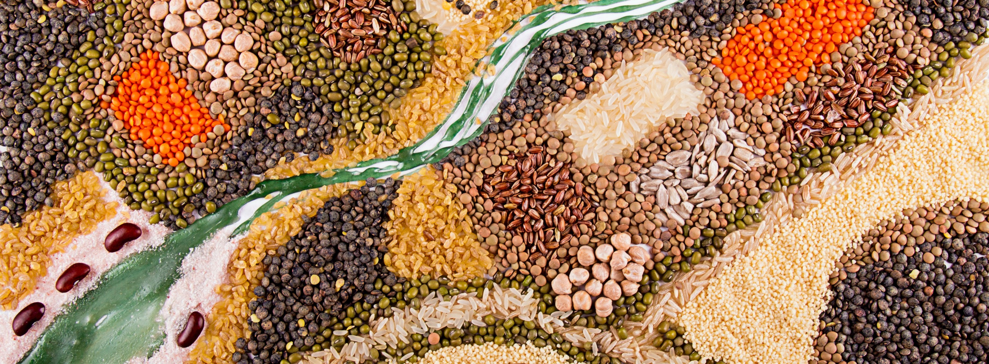
THANK YOU
MARIAM@ACBIO.ORG.ZA

